Slide 1

NEXTHIKE IT SOLUTIONS
To Perform Data-Wrangling on a set of Datasets

Slide 2
Project Overview
This project is related to perform data wrangling on a set of datasets.
We have to identify and apply different data-wrangling techniques to get a dataset for further usage.
Libraries used:
Pandas
Numpy
Seaborn
Matplotlib

Slide 3
Data Acquisition and Data Wrangling
Data Acquisition and Data Wrangling are foundational to becoming proficient in data analysis, machine learning, and data-driven decision-making.
We can gain:
1. Understanding Data Sources
Knowledge of different types of data sources (e.g., files, APIs, databases, web scraping).
Ability to identify and collect data from appropriate sources based on project requirements.
2. Proficiency in Data Importing
Learning to use tools like pandas, numpy, and others to import data from formats such as .csv, .json, .xls, or databases like SQL.
3. Cleaning and Preprocessing Data
Handling missing data, duplicate records, inconsistent formats, and outliers. Gaining expertise in reshaping and reorganizing data for usability.
4. Data Transformation
Using techniques to transform raw data into structured forms (e.g., normalizing, scaling, encoding categorical data). Learning to create new variables/features to enrich the dataset.
5. Error Detection and Correction
Acquiring skills to detect inconsistencies, errors, or anomalies in the data and correct them effectively.

Slide 4
6. Exploratory Data Analysis (EDA)
Using tools to summarize, visualize, and understand the data distribution, relationships, and patterns.
7. Feature Engineering
Learning how to manipulate and enhance data features to improve the performance of machine learning models.
8. Improved Decision-Making
Understanding the importance of clean, accurate, and well-prepared data for drawing meaningful insights and making informed decisions.
9. Tool Familiarity
Gaining hands-on experience with libraries and frameworks such as:
Python: pandas, numpy, seaborn, matplotlib, scikit-learn.
R or other data manipulation tools, depending on context.
10. Efficient Workflow
Developing robust workflows for automating repetitive data wrangling and acquisition tasks, saving time and effort.

Slide 5
Steps involved in Data-Wrangling
Finding number of rows, columns, Data Type, unique values and Data Info.
Drop the duplicate columns
df_cleaned = df_cleaned.drop_duplicates()
df_cleaned = df.dropna()
column_to_drop = "Unnamed: 0"
if column_to_drop in df_cleaned.columns:
df_cleaned = df_cleaned.drop(columns=[column_to_drop])
output_file = "cleaned_dataset_1.csv"
df_cleaned.to_csv(output_file, index=False)
print(f"Cleaned data has been saved to {output_file}.")
This way we can clean all the 3 datasets.

Slide 6
Merging the cleaned Datasets
df1 = pd.read_csv('cleaned_dataset_1.csv’)
df2 = pd.read_csv('cleaned_dataset_2.csv’)
merged_df = pd.merge(df1, df2, on='instant', how='inner’)
merged_df.to_csv('merged_dataset_12.csv', index=False)
This way we can merge the cleaned datasets. First we will merge the cleaned dataset 1 with cleaned dataset 2. After merging we will get a new dataset and then we will merge the new dataset with the cleaned dataset 3. Finally we will get the final required dataset.

Slide 7
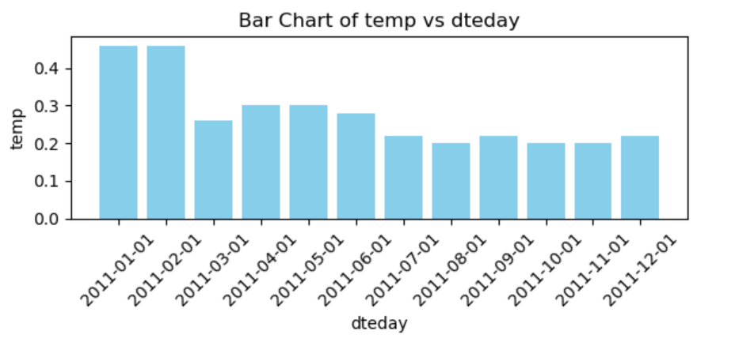
Bar Chart
A bar chart (or bar graph) is a type of data visualization that represents categorical data using rectangular bars. The length or height of each bar is proportional to the value it represents, making it an effective way to compare different categories, groups, or data points.
Bars:
Bars can be vertical (column chart) or horizontal.
Their height or length represents the magnitude of the data values.
Axes:
One axis (usually the X-axis or the Y-axis) represents the categories or groups.
The other axis shows the numerical values (e.g., counts, percentages, or frequencies).
Spacing:
Bars are usually separated by spaces to differentiate between categories.

Slide 8
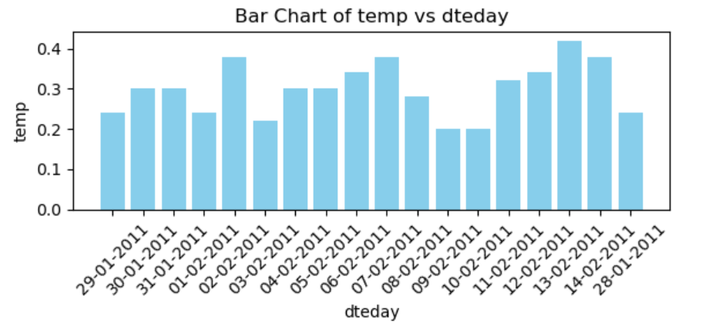
Bar Chart created on cleaned Dataset 3
df = pd.read_csv('cleaned_dataset_3.csv')
x_column = "dteday"
y_column = "temp"
if x_column in df.columns and y_column in df.columns:
plt.figure(figsize=(6, 3))
plt.bar(df[x_column], df[y_column], color='skyblue')
plt.xlabel(x_column)
plt.ylabel(y_column)
plt.title(f"Bar Chart of {y_column} vs {x_column}")
plt.xticks(rotation=45)
plt.tight_layout()
plt.show()
else:
print(f"Make sure the columns '{x_column}' and '{y_column}' exist in the dataset.")

Slide 9
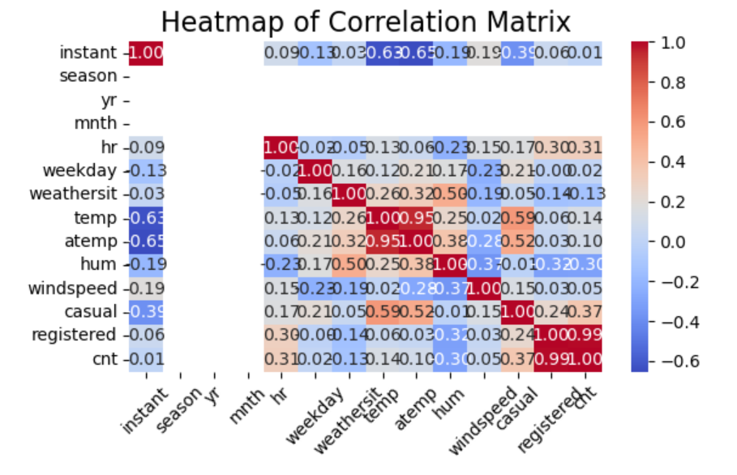
Heatmap Chart
A heatmap is a data visualization tool that uses a grid of colored cells to represent values in a dataset. The color intensity or shade in each cell corresponds to the magnitude or frequency of the value, making it easy to identify patterns, correlations, or outliers in the data at a glance.
Key Features:
Color-Coded Representation: Different colors or gradients signify varying value ranges. For example, red might indicate high values, while blue indicates low values.
Matrix-Like Layout: Typically shown as a matrix where rows and columns represent variables, and cell colors depict relationships or values.
Correlation Analysis: Heatmaps are commonly used to visualize correlation matrices in data analysis, where the strength of relationships between variables is shown.

Slide 10
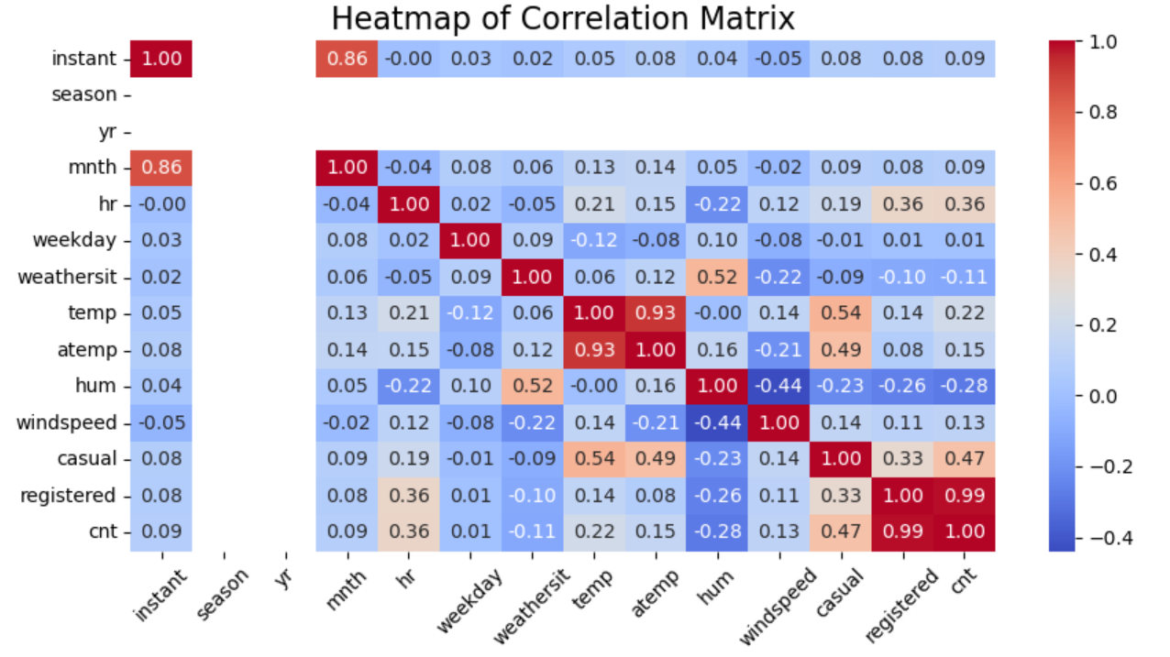
Heatmap of correlation matrix drawn on merged dataset123
df = pd.read_csv('merged_dataset_123.csv’)
print(df.head())
heatmap_data = df.select_dtypes(include=["number"])
plt.figure(figsize=(9, 5))
sns.heatmap(heatmap_data.corr(), annot=True, fmt=".2f", cmap="coolwarm", cbar=True)
plt.title("Heatmap of Correlation Matrix", fontsize=16)
plt.xticks(rotation=45, fontsize=10)
plt.yticks(fontsize=10)
plt.tight_layout()
plt.show()

Slide 11
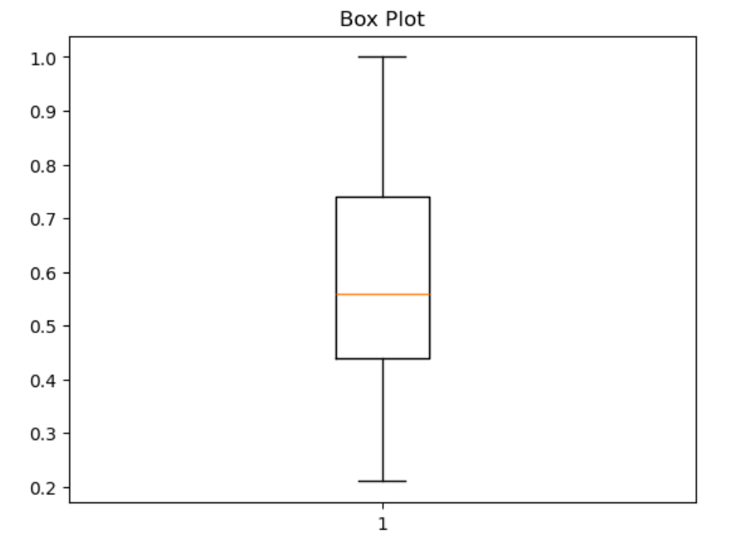
Box Plot Chart
A box plot (also called a box-and-whisker plot) is a statistical visualization that summarizes the distribution of a dataset and highlights its key characteristics. It provides a compact way to display variability, central tendency, and potential outliers in data.
Box:
The box represents the interquartile range (IQR), which is the range between the first quartile (Q1, 25th percentile) and the third quartile (Q3, 75th percentile).
The line inside the box shows the median (Q2), which is the 50th percentile.
Whiskers:
The lines extending from the box indicate the range of the data, typically up to 1.5 times the IQR from Q1 and Q3.
Any data points outside this range are considered outliers.
Outliers:
Outliers are individual points plotted beyond the whiskers. These are values significantly higher or lower than the rest of the data.

Slide 12
Skewness and Correlation Matrix
Skewness
Skewness measures the asymmetry of the distribution of data around its mean. It tells us whether the data is skewed to the left (negative skew), skewed to the right (positive skew), or symmetric.
Types of Skewness:
Negative Skew (Left-Skewed): The tail of the distribution is longer on the left side. Most data points are concentrated on the right.
Positive Skew (Right-Skewed): The tail of the distribution is longer on the right side. Most data points are concentrated on the left.
No Skew (Symmetric): The distribution is perfectly balanced on both sides, like a normal distribution.
Correlation Matrix
A Correlation Matrix is a table that shows the pairwise correlation coefficients between multiple variables in a dataset. Correlation measures the strength and direction of the linear relationship between two variables.
Values in the Matrix:
Range: Correlation coefficients range from -1 to 1:
1: Perfect positive correlation (both variables move in the same direction).
-1: Perfect negative correlation (one variable increases while the other decreases).
0: No linear relationship.

Slide 13
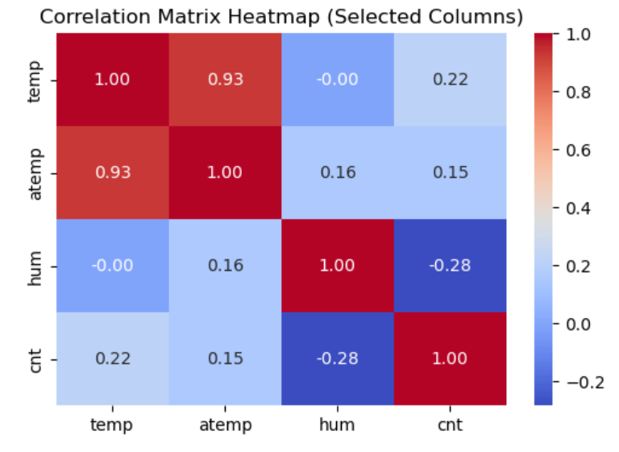
Skewness and Correlation Matrix of selected columns
df = pd.read_csv("cleaned_merged_dataset_123.csv")
selected_columns = ["temp", "atemp", "hum", "cnt"]
existing_columns = [col for col in selected_columns if col in df.columns]
if existing_columns:
print("Skewness of Selected Columns:")
skewness = df[existing_columns].skew()
print(skewness)
print("\nCorrelation Matrix of Selected Columns:")
correlation_matrix = df[existing_columns].corr()
print(correlation_matrix)
plt.figure(figsize=(8, 6))
sns.heatmap(correlation_matrix, annot=True, cmap="coolwarm", fmt=".2f")
plt.title("Correlation Matrix Heatmap (Selected Columns)")
plt.show()
else:
print("None of the selected columns exist in the dataset. Please check the column names.")

Slide 14
Thank You

